Slide 1
CS 4530: Fundamentals of Software Engineering Lesson 5.3 Continuous Integration
Rob Simmons
Khoury College of Computer Sciences

Slide 2
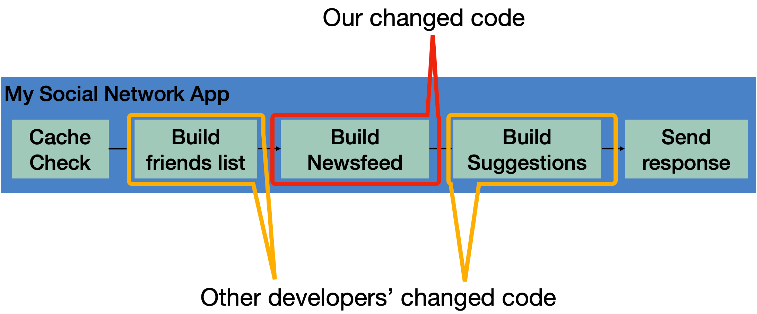
Continuous Integration (CI) provides global feedback on local changes
Given: Our systems involve many components, some of which might even be in different version control repositories
Consider: How does a developer get feedback on their (local) change?
Notes:
Continuous integration is particularly relevant in software that involves multiple components. A developer might change code in one component, say, the code that handles building the newsfeed that will show up in the returned page. This might live in one repo, and be an independent component. However, this component is part of a bigger, overall application, which consists of other components: the newsfeed probably depends on other components (like that which builds a friends list), and there might be other components that depend on the newsfeed (like something that builds a list of suggestions). There might be even more complex interactions with other components: like perhaps before sending a response back to a client, the server will save the response into a cache, and on repeated requests, that cache is served. There might be other changes going on, too - other developers are likely working on changing other components at the same time. Traditional waterfall or even agile development processes often involve performing integrations between all of these changes infrequently - perhaps weekly or monthly. The idea behind continuous integration is to integrate these changes and test them rapidly - as soon as they are created.

Slide 3
A CI process is a software pipeline
Automate this centrally, provide a central record of results
Develop
Build
Test
Deploy
Monitor
Code Review
Style Check
Integration Test
End-to-end Test
KPIs
0…………….
Compile
Load Test
Unit Test
Prepare Deployment
Notes:
So, the core to continuous integration is to centrally and automatically execute these development processes, regularly.
With CI, we continuously assemble and test changes to our codebase. By performing these integrations quickly and frequently, we can get faster feedback, and hence, “shift left” - allowing bugs to be detected sooner. There’s an enormous difference in how long it takes to debug something if you detect the bug immediately after writing the code versus even, say, the next day - let alone after several weeks.
CI processes are software pipelines. “Pipeline” systems are good for building systems that have a specific order of operations, with dependencies between some steps. CI workflows follow this pattern: some steps depend on others (can’t test until you build), but many steps might be possible in parallel (run many different kinds of tests concurrently)
Consider our “social network application”, where we are changing code that builds a newsfeed, and other developers are changing other parts of the code? What concrete steps do you think that we should include in the build/test CI? Keep in mind that these might be things that you would otherwise do manually, but now have decided to automate.
<Examples, in case they don’t come up: Run unit tests, run integration tests, run international localization tests, validate that it still works with some infrastructure deployment, do regression testing, accessibility testing, check/gate on various quality metrics like coverage, security audit, code review>

Slide 4
CI may be triggered by commits, pull requests, or other actions
Example: Small scale CI, with a service like CircleCI, GitHub Actions or TravisCI
GitHub
commits code to
checks for updates
Developer
GitHub Actions
TravisCI
CircleCI
Runs build for each commit
Notes:
Run an entire test suite on each commit, or perhaps do other things. Each commit triggers some workflow to run, and we can customize that workflow to do anything from building our code, to running tests, to deploying infrastructure.

Slide 5
Automating Feedback Loops is Powerful
Consider tasks that are done by dozens of developers (e.g. testing/deployment)
© Randal Munroe/xkcd, licensed CC-BY-SA
https://xkcd.com/1205/
Notes:
This XKCD comic does a nice job visually summarizing the value of automating feedback loops. It is a table that shows how much time you would save over a 5 year period if you automated a task (with the Y axis showing how long the task takes otherwise and the X axis showing how often you do the task). There are, for sure, some tasks that are unlikely to be worth automating – those that are very fast to do and that you do infrequently.
However, there are also some tasks that you clearly should automate: if there is something that takes you 30 minutes to do every day, you will save 5 weeks of time over a 5 year period if you could automate it.
Something that this table *doesn’t* take into account is that you might want to do that task MORE OFTEN than you do, but doing it manually just costs too much. For example: maybe running some test suite takes 30 minutes, and so you only do it once a week. If you COULD run it without taking you away from another task – perhaps you would run it more frequently?
<Ask students for examples of tasks that they have decided to automate on different projects/life/etc>
<Note that there are a lot of hidden man-hours into maintaining automation, and the cost of monitoring>

Slide 6
Typical CI pipeline
Set up testing environment
Set up tests
Set up multiple input
Run all tests against all inputs
(preferably in parallel)
Record results and performance in central db
Big Data (lots of work)
Partition
Stage 1
Stage 1
Stage 1
Stage 1
Stage 1
Stage 2
Stage 2
Stage 2
Stage 2
Stage 2
Stage 3
Stage 3
Stage 3
Stage 3
Stage 3
Combine
Result
Notes:
This would be hard to do reliably by hand, so we set it all up with scripts of various sorts
Tools like github or travis CI provide tools to write the necessary scripts and run them.

Slide 7
You could set up multiple CI processes
Run a short test daily
or oftener
maybe on every commit?
More comprehensive test less often
provides more accurate performance data
Either way, you know that your integration is working!

Slide 8
Continuous Integration is Highly Configurable
Determining how to apply CI can be non-trivial for a larger project, all with a cost vs quality tradeoff: what is the cost of automation vs the value of developer time?
Do we integrate changes immediately, or do a pre-commit test?
Which tests do we run when we integrate?
When do we integrate code review?
How do we compose the system under test at each point?
Changed code
My Social Network App
Cache Check
Build friends list
Build Newsfeed
Build Suggestions
Send response
Other developers’ changed code
Notes:
Immediately/pre-commit: small project with a few commits a day and a test suite under 30 mins, probably integrate immediately and run full test suite. But: consider our social network app, where we might have 20 changes/hour and a 30 mins test suite, when do you choose to integrate things? Do we wait for last integrated change to pass before integrating next?
Which tests to run - again, easy on small. But: what if our big social network app: we probably should also run tests that could depend on this (like other components of our request pipeline). At the limit: maybe now our new newsfeed change will impact how the request caching feature works, and we should check that too. Do we check everything?
How do we compose system under test - do we use mocks for external services, or do we use production, or do we make a special environment for each integration test?

Slide 9
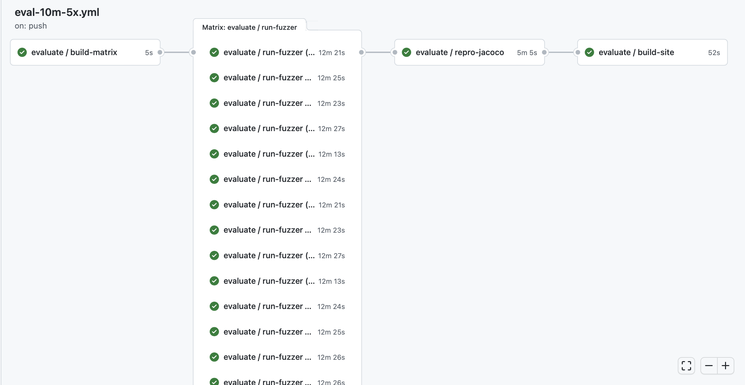
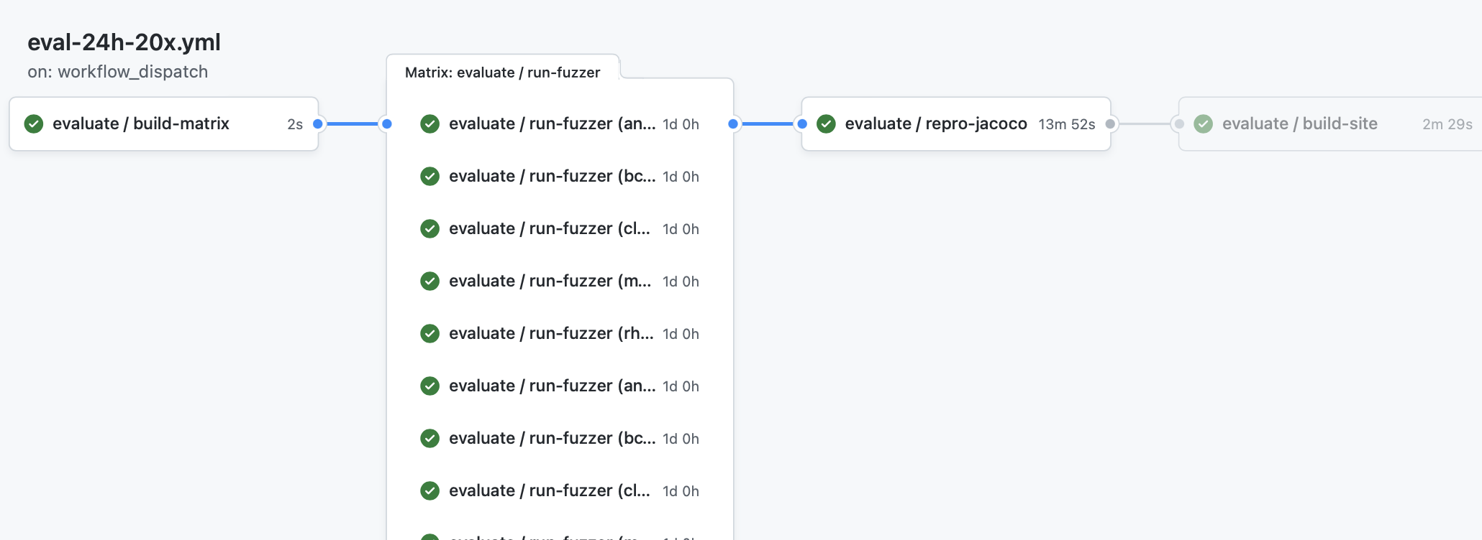
CI pipelines can automate performance testing
Every commit: Run 10 minute performance test on 5 benchmarks, repeating each test 5 times (25 concurrent jobs)
On Demand: Run 24 hour performance test on 5 benchmarks, repeating each test 20 times (100 concurrent jobs)
https://github.com/neu-se/CONFETTI/actions
Notes:
These screenshots show the graphical summary of two CI pipelines set up for a software testing research tool.
The top one shows a workflow that can run on every commit, providing useful feedback on performance and correctness in about 15 minutes: running a 10 minute performance test on 5 benchmarks, repeating each one 5 times (25 concurrent jobs needed)
The bottom one shows a workflow that runs only upon request, which performs a much more thorough evaluation: 20 repetitions of 5 benchmarks, with each running for 24 hours.
In both cases, there are 4 jobs defined: 1. build the matrix (run a script that will determine which benchmarks to run), 2. (in parallel) run the fuzzer on those benchmarks, 3. collect all of those results and reproduce them for later analysis, and 4. render a report into markdown and HTML that summarizes the results

Slide 10
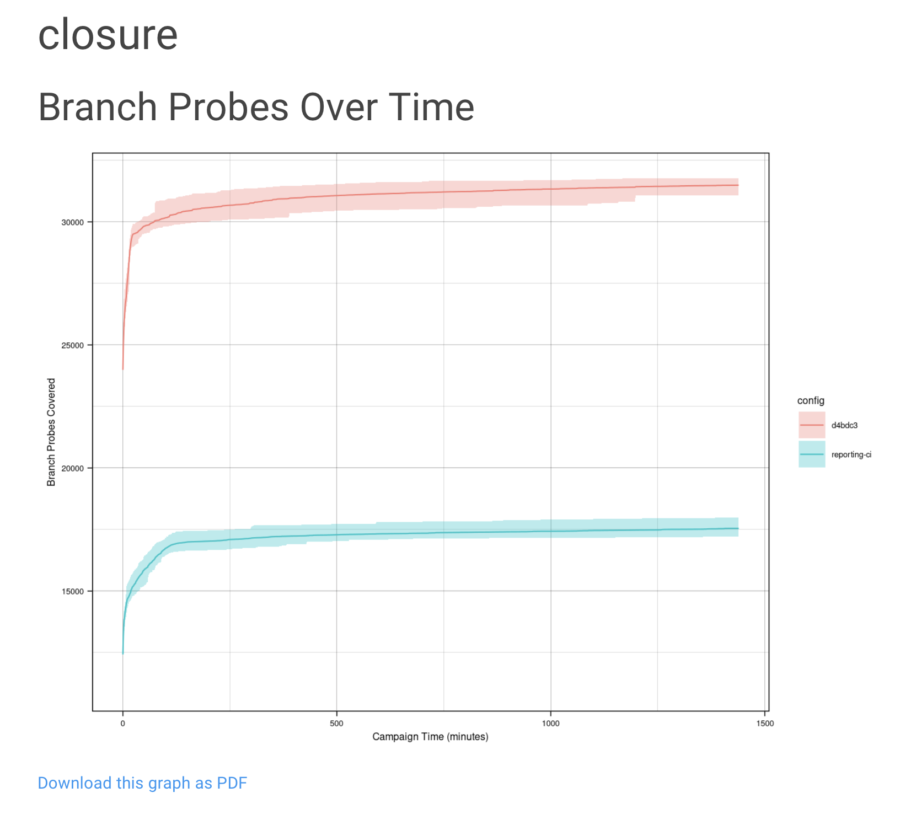
CI pipelines can automate benchmarking
On Demand: Run 24 hour performance test on 5 benchmarks, repeating each test 20 times (100 concurrent jobs)
https://github.com/neu-se/CONFETTI/actions
Notes:
Automating this kind of performance testing lets us get feedback much faster than if we had to do it manually. It also allows us to have a centralized repository of those results, so that we can track performance over time.
Here is an example of one of the graphs that get output from the report.
“branch probes over time” is one of the key performance indicators that fuzzers like this one are evaluated on. Since all of the data is centrally stored, it is easy to automate reports like this that compare the performance on the current commit to, say, another branch. This graph shows in red the current commit, and in blue, the main development branch.

Slide 11
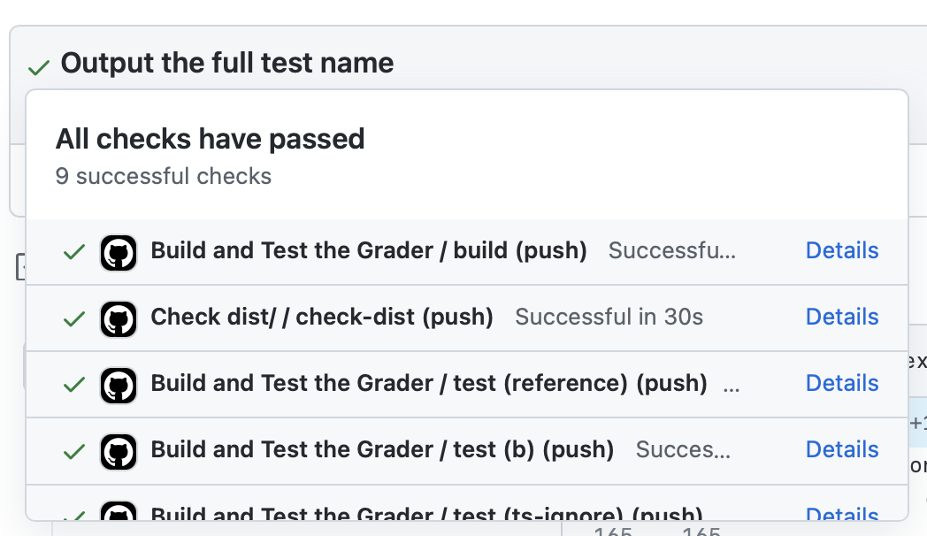
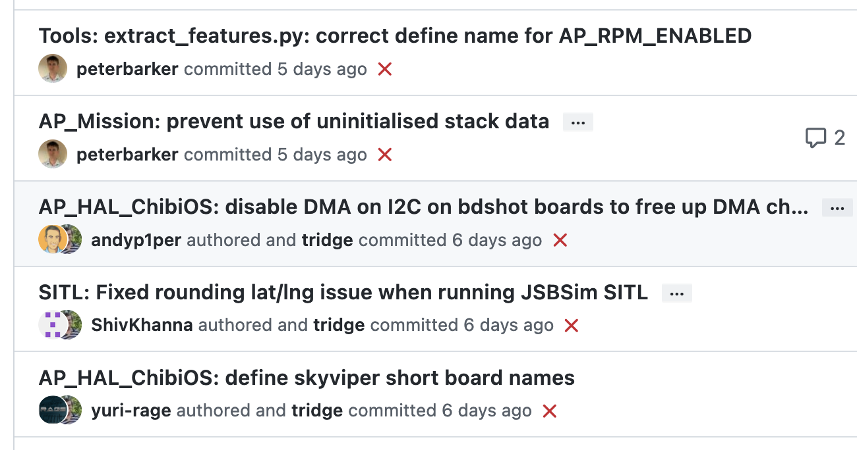
Attributes of effective CI processes
Policies:
Do not allow builds to remain broken for a long time
CI should run for every change
CI should not completely replace pre-commit testing
Infrastructure:
CI should be fast, providing feedback within minutes or hours
CI should be repeatable (deterministic)
Notes:
<read slide, some notes below:
When builds are persistently broken (failing on each change), as in the screenshot on the bottom right, developers start to ignore the outcomes.
Run on every change for the reason we just saw – reduces debugging effort
Still do pre-commit testing locally (before CI). Think about the difference between running `npm test` for IP2, vs submitting to autograder. Why would you do tests locally? -> even faster feedback
- Repeatable is important because you want to be able to reproduce same result again and again when debugging. The alternative is maybe called “flaky” and means that your CI pipeline fails due to reasons besides introducing a defect in the code, more on next slide
>

Slide 12
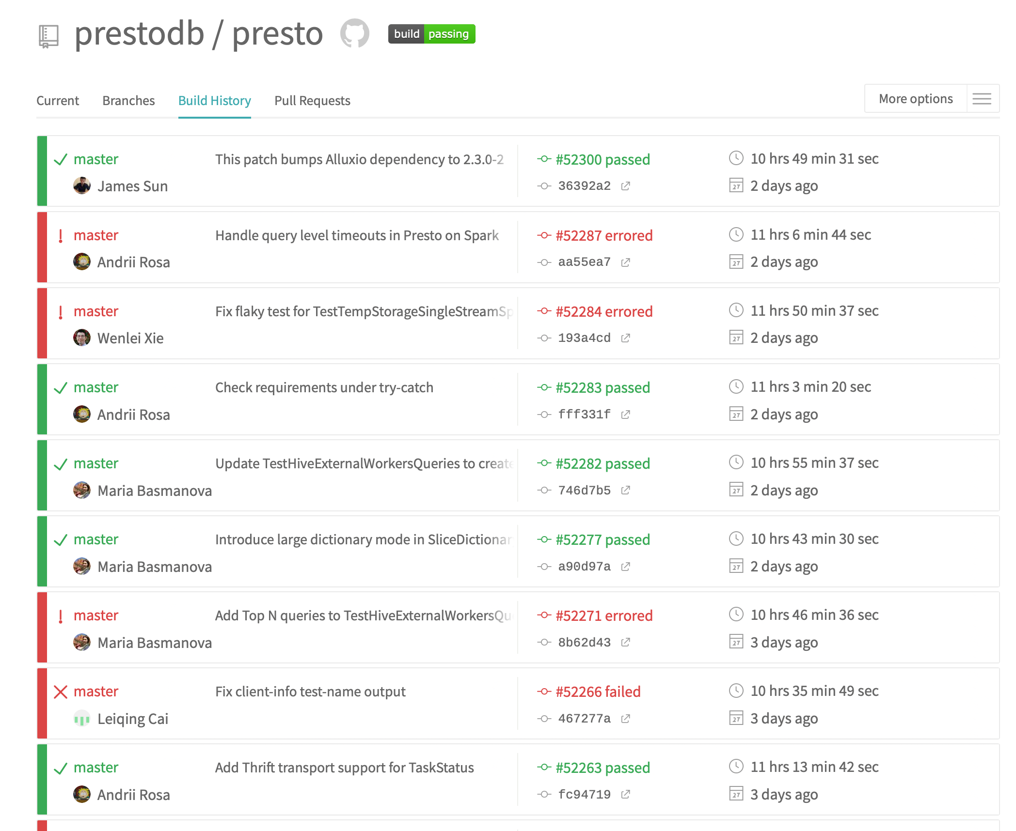
Effective CI processes are run often enough to reduce debugging effort
Failed CI runs indicate a bug was introduced, and caught in that run
More changes per-CI run require more manual debugging effort to assign blame
A single change per-CI run pinpoints the culprit
Notes:
<read slide. Consider the difference between integrating 100 commits and finding a bug vs integrating 2 commits and finding a bug. It will be much easier to figure out what introduced the bug when you only have those 2 commits!>

Slide 13
Effective CI processes allocate enough resources to mitigate flaky tests
Flaky tests might be dependent on timing (failing due to timeouts)
Running tests without enough CPU/RAM can result in increased flaky failure rates and unreliable builds
“The Effects of Computational Resources on Flaky Tests”, Silva et al
Notes:
<read slide>
The figure shows an experiment where the authors studied 30 open source projects’ CI workflows, running them 300 times each in 11 different resource configurations offered by popular cloud providers like AWS. The figure shows that some configurations that were cheaper to run (green bar) often were NOT the most reliable conifgurations – those cheaper configurations resulted in more flaky test failures.

Slide 14
Challenges and Solutions for Repeatable Builds
Which commands to run to produce an executable? (build systems)
How to link third-party libraries? (dependency managers)
How to specify system-level software requirements? (containers)
How to specify infrastructure requirements? (Infrastructure as code)
Notes:
There are four main challenges (and solutions) to repeatable CI builds. <read slide>
We’ll talk briefly about build systems, dependency managers and infrastructure as code. You’ll remember containers from our last lecture, on cloud deployment technologies.

Slide 15
Build Systems Orchestrate Software Engineering Tasks
“Orchestrate” -> Execute in the right order, ideally with concurrency, example tasks:
Installing dependencies
Compiling the code
Running static analysis
Generating documentation
Running tests
Creating artifacts for customers
Deploying Code
Example build systems: xMake, ant, maven, gradle, npm…
Notes:
<read slide>
In most modern languages, the build system itself also serves as the dependency manager (e.g. Maven). Other tools focus more on providing dependency management (e.g. npm), and do not directly support the same kind of modular workflows as more powerful build systems (e.g. “grunt” is a build tool for NodeJS)

Slide 16
Dependency Managers Organize External Dependencies
Addresses this problem: “Before you compile this code, install commons-lang from the Apache website”
Declare a dependency using coordinates (unique ID of a package plus version)
Packages are archived in common repositories; fetched/linked by dependency manager
Dependency managers handle transitive dependencies 🐉
Examples: Maven, NPM, pip, cargo, apt
Notes:
<read slide. There are dragons in “transitive dependencies” but that is the subject for another lecture that we would probably need to call “dependency hell”>

Slide 17
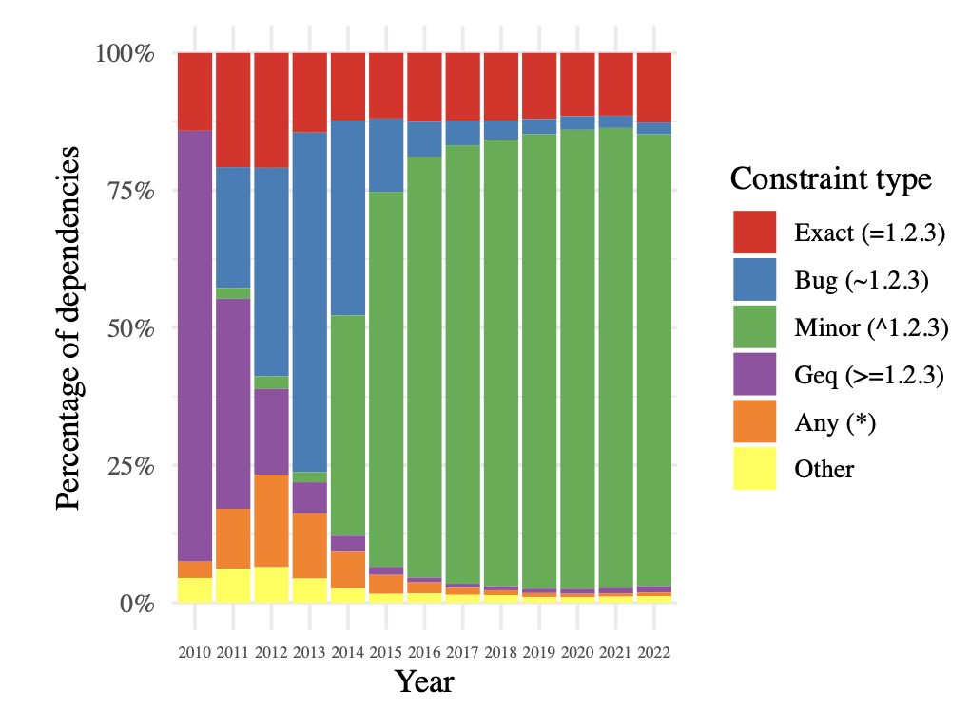
Specify and Depend on Package Versions with Care
Semantic Versioning is often expected:
Library maintainers expected to indicate breaking changes with version numbers
Dependency consumers can specify constraints on versions (e.g. accept 2.0.x)
Distribution of dependencies of all packages in NPM over time (2023, Pinckney et al)
Notes:
Semantic versioning is a generally-agreed-upon mechanism for creating and maintaining version numbers. The reason for this standard is to make it easier for library maintainers (publishing new code) to tell their consumers when breaking changes are expected.
The summary of semantic versioning is shown in the screenshot to the right. With semantic versioning (“semver”), you specify a version number as MAJOR.MINOR.PATCH. Incrementing the major number indicates that you are definitely making incompatible API changes. Incrementing the minor version indicates that there is new functionality from the prior version, but should be backwards-compatible. Incrementing the patch version indicates that you are making a backwards-compatible bug fix
Consumers of dependencies (e.g. your project that uses NPM to install dependencies) can specify constraints on dependency versions to, for example, allow for the dependency manager to automatically upgrade to a new patch version, new minor version, new major version, or to require a specific version.
The stacked bar charts on the left show the distribution of all dependencies of all packages in the NPM dependency ecosystem by-year. While at first, the typical approach was to allow changes to major versions to be applied automatically (purple, greater-or-equal constraint), over time this quickly shifted to allowing for bug (”patch”) and minor version increments. Of course, this only works if developers RELEASING packages follow these rules, and don’t introduce breaking changes in minor or patch updates!

Slide 18
Continuous Integration Service Models
Self-hosted/managed on-premises or in cloud
Jenkins
Fully cloud managed
GitHub Actions, CircleCI, Travis, many more…
Billing model: pay per-build-minute running on SaaS infrastructure
“Self-hosted runners” run builds on your own infrastructure, usually “free”
Notes:
As with many other software infrastructure components, you could configure, deploy and maintain your own CI infrastructure (that runs your CI workflow), or use a vendor’s CI service, provided in a “software-as-a-service” model.
An example of the oldest/most commonly used self-hosted open-source CI solution is “Jenkins”. There are also vendors who will run this as a service for you, if you would want that.
In the past decade, there has also been a rise in the popularity of SaaS-style CI services, like GitHub Actions ,Circle CI, Travis, and others. These services typically bill per-minute that builds run for. GitHub Actions supports a hybrid model, where GitHub hosts the whole system for triggering CI runs and collecting their output, and you bring your own “runner” that runs CI jobs. This approach lets you use your own specialized infrastructure (e.g. GPUs that you bought for some ML project), and if you do so, you can avoid paying the per-minute fee to use the vendor’s infrastructure.

